Slide 1
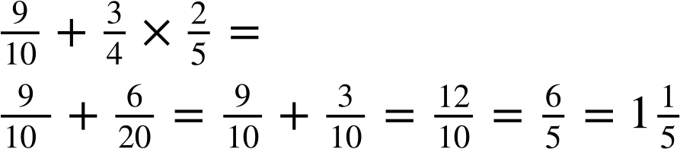
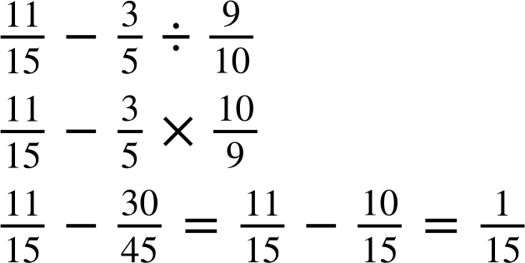
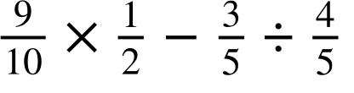
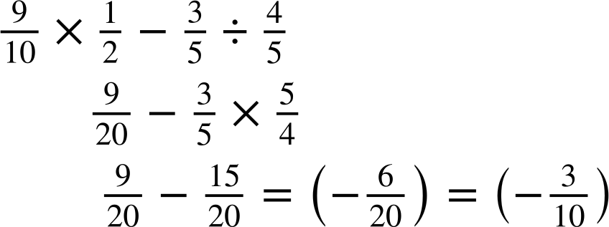
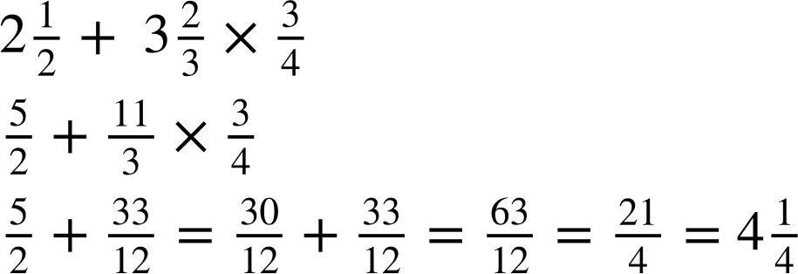
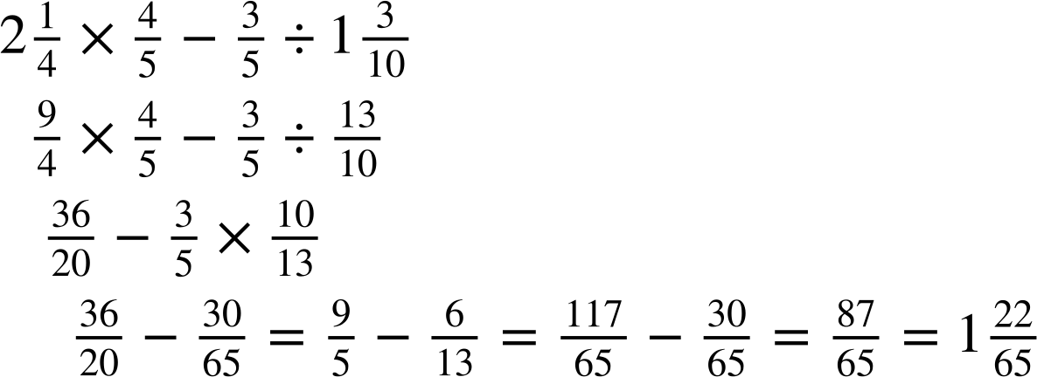
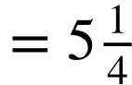
Priority of operations with positive and negative integers, decimals and fractions
Task A: Reviewing priority of operations
1) Work out the following using the priority of operations, giving your answer in its simplest form where possible.
a)
b)
c)
2) Work out the following using the priority of operations, giving your answer in its simplest form and a mixed number where possible.
b)

Slide 2
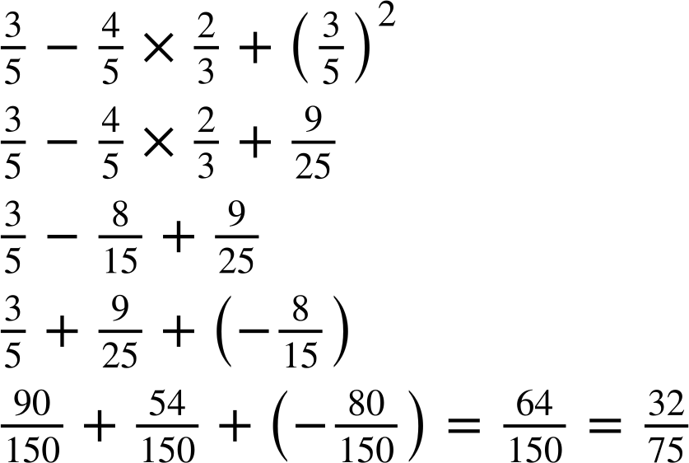
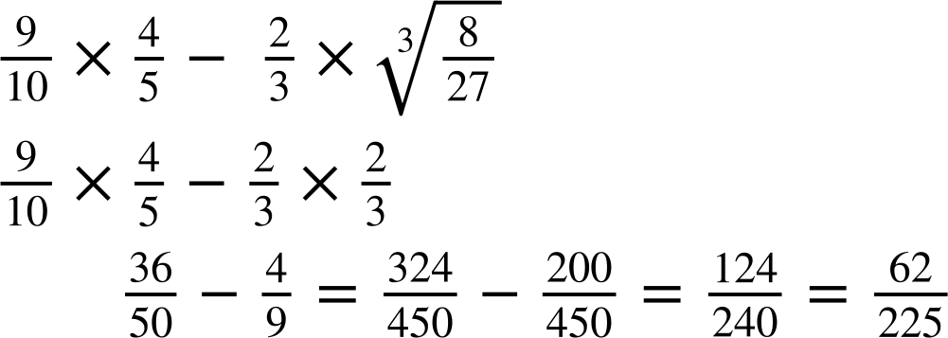
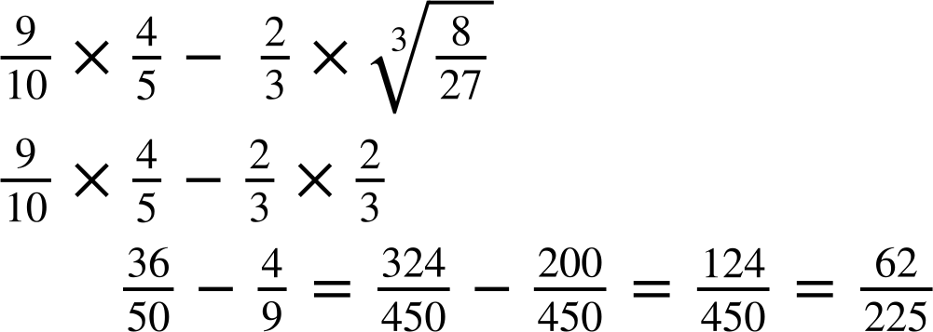
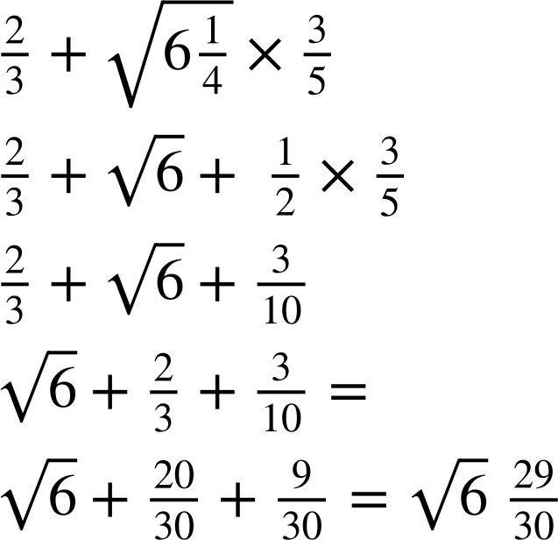
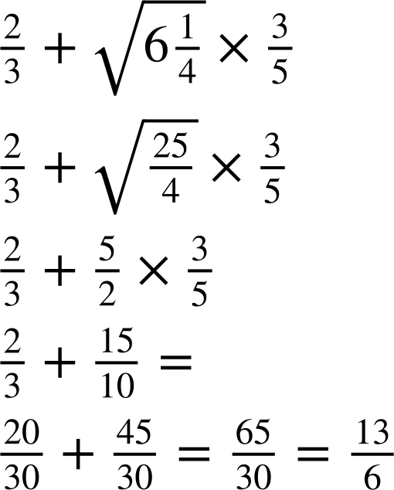
Priority of operations with positive and negative integers, decimals and fractions
Task B: Powers and roots of fractions
1) Fill in the blanks to complete the calculation
2) Work out the answer to the following, giving your answer in its simplest form.
3) Lucas has made an error.
Find the error and correctly complete the calculation
Lucas needed to convert the mixed number into an improper fraction first

Slide 3
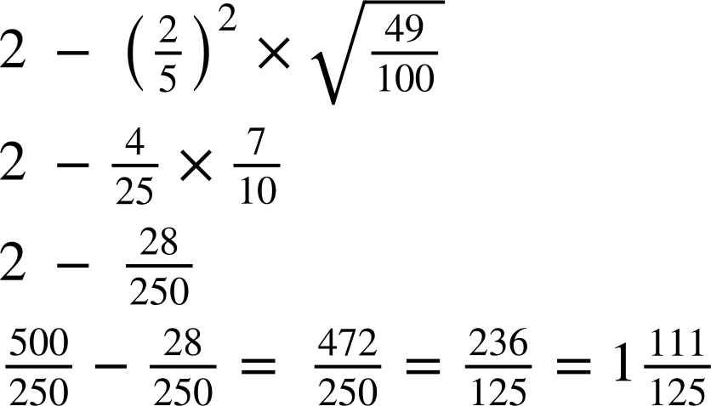
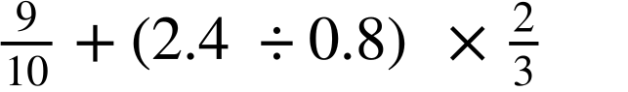
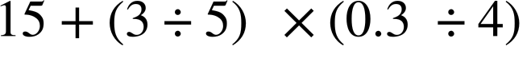
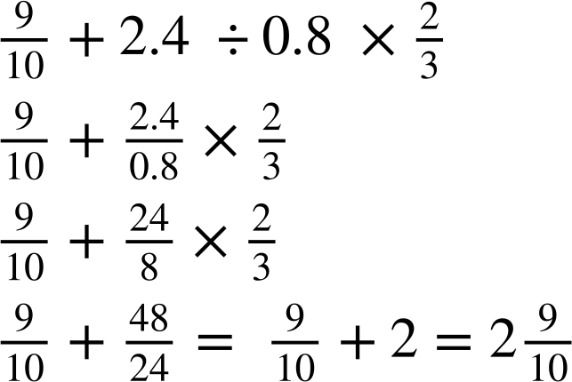
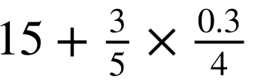
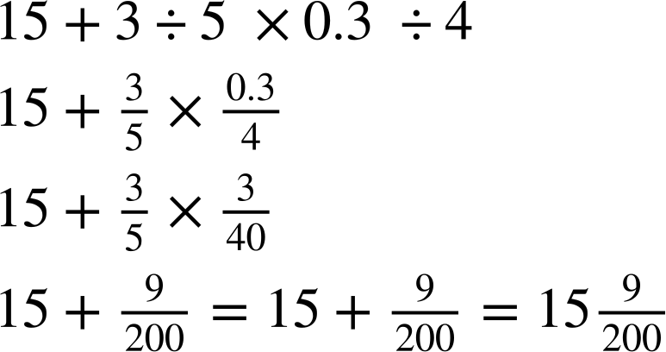
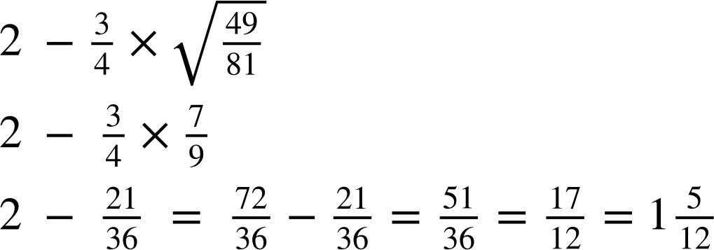
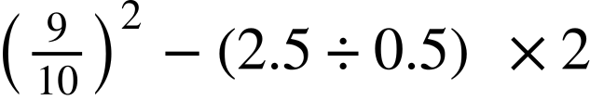
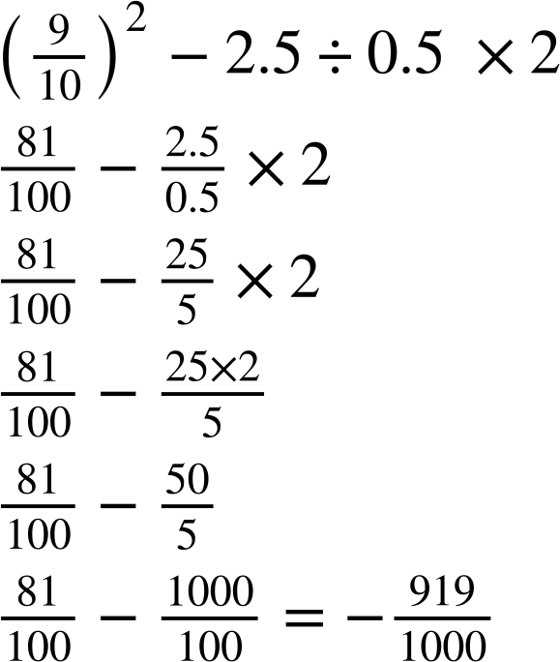
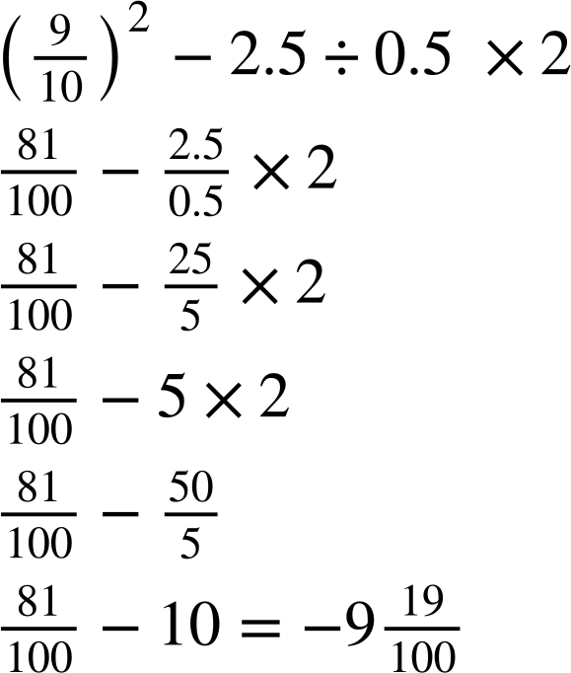
Priority of operations with positive and negative integers, decimals and fractions
Task C: Powers and roots of fractions
1) Fill in the blanks to complete the calculation
2) Work out the answer to the following, ensuring to give your answer as a mixed number in its simplest form
a)
b)
3) Work out the answer to the following, ensuring to give your answer as a mixed number in its simplest form
a)
b)
Mathematics in Education and Industry
v2.2

